Slide 1
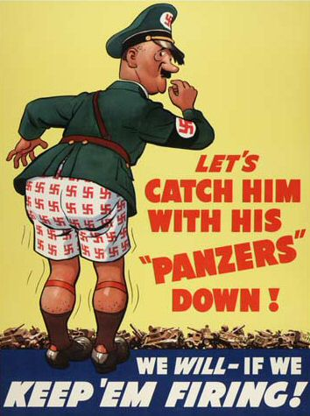
The Deepening of the European Crisis: World War II
By: Haley Anderson

Slide 2
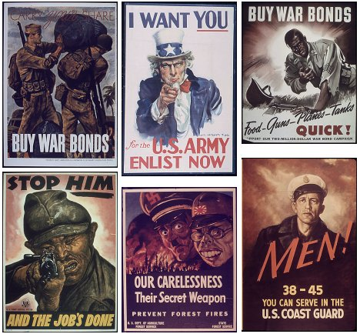
Prelude to the War (1933-1939)
Just 20 years after WWI, Europe went back to total war. The efforts of the league of nations, the attempts of disarmament, the pacts and the treaties all were meaningless to the growth of Nazi Germany. No one was even thinking of another war…

Slide 3
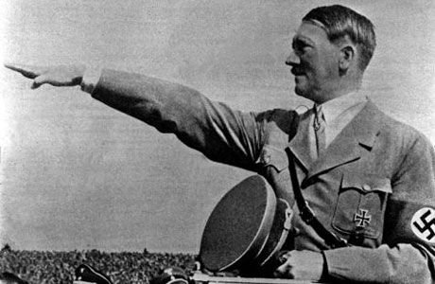
The Role of Hitler
Adolf Hitler was a firm believer in the doctrine of lebensraum (living space). Germany needed more land to support a larger population and be a great power. The doctrine of Lebensraum maintained that a nation’s power depended on the amount and kind of land it occupied. Hitler knew what he wanted from the very beginning and knew what he had to prepare for: Germany’s inevitable war with the Soviet Union.

Slide 4
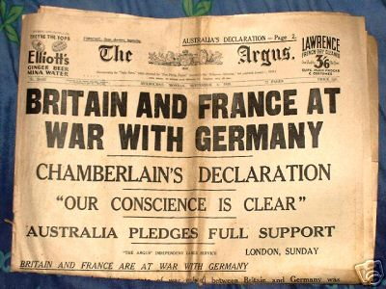
The “Diplomatic Revolution” (1933-1936)
The Versailles Treaty had created a demilitarized zone on Germany’s western border and also limited their army to 100,00 troops with no air and limited naval forces. To be able to rearm Germany and fulfill expansionist policies depended initially on whether he could convince others that his intentions were peaceful. Hitler withdrew Germany from the Geneva disarmament conference and the league of nations was done so that Germans no longer felt dominated by other European states.
The Anglo-German naval pact allowed Germany to rebuild a navy that’s 35% the size of the British navy, with equality in submarines. The British started a policy of appeasement . Hitler moved troops into the demilitarized zone of Rhineland. France and Britain did nothing.
Hitler gained new allies. Benito Mussolini of fascist Italy, who invaded Ethiopia, and Hitler had concluded an agreement that recognized their common political and economical interests. Germany and Japan concluded the anti-comintern pact and agreed to maintain a common front against communism.

Slide 5
The Path to War (1937-1939)
Neville Chamberlain had made it known to Hitler that he would not oppose changes in central Europe, as long as they were done in peaceful ways.
Hitler decided to move first on Austria. Hitler had put Nazis in charge of the Austrian government. One day later, Hitler annexed Austria to Germany. Hitler’s next step was to smash Czechoslovakia by military action.
Hitler ordered the cession of the Sudetenland to Germany and expressed his willingness of “world war” to reach his goal. At the Munich conference, the British, French, Germans, and Italians reached an agreement: German troops were allowed to occupy the Sudetenland. At the end of October 1938, Hitler told his generals to prepare for the final liquidation of the Czechoslovakian state. Hitler occupied the Czech lands and encouraged the Slavs to declare their independence of the Czechs and became a puppet state of Nazi Germany (Slovakia).
Hitler demanded the return of Danzig to Germany. Hitler created the nonaggression pact with the soviet union as he invaded Poland. Finland, the Baltic states, and eastern Poland would go to the soviets. 2 days after the invasion of Poland, Britain and France declared war on Germany.

Slide 6
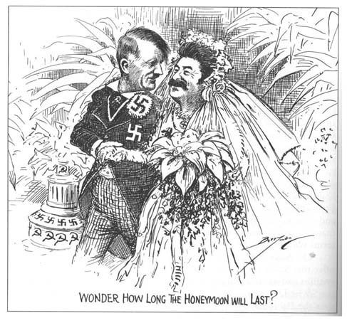

Slide 7
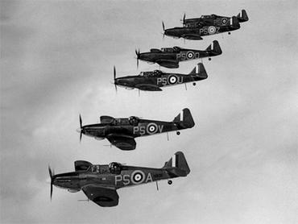
Victory and Stalemate
Blitzkrieg or “lightning war” was Hitler's tactic of speed and efficiency for his army attacks. France had built a series of concrete and steel fortifications armed with heavy artillery- known as the Maginot line- along its border with Germany. Hitler used Blitzkrieg against Denmark and Norway next. Then one month later, on may 10th, Germans attacked the Netherlands, Belgium, and France. The panzer divisions (strike force of about 300 tanks and accompanying force and supplies) broke through the Maginot line and split the allied armies trapping them on the beaches of Dunkirk. British made a heroic rescue effort and evacuated an army of 330,000 allied troops. Mussolini declared war on France and invaded from the south. The remainder of what the Germans didn’t occupy became known as Vichy France. Allies referred to this as a Nazi puppet state.
Winston Churchill had replaced Chamberlain. Hitler needed to take control of the air. So in august 1940, the Luftwaffe launched a major offensive against British air naval bases, harbors, communication centers, and war industries. British had an effective radar system that gave them early warning of the Luftwaffe. They also had the Ultra Intelligence Operation which had broken German military codes. Hitler ordered massive bombings of the cities to break British morale. Germany lost the Battle of Britain.

Slide 8

Continued…
At the end of July 1940, Hitler told his army leaders to prepare for the invasion of the Soviet Union. He had believed that the Soviet’s Jewish-Bolshevik leadership would be defeated quickly. The invasion was delayed because Italy had needed help in the Balkans. German troops seized Yugoslavia and Greece. German troops had moved quickly to the Ukraine, Leningrad, and Moscow (capital). German armies had been stopped for the first time due to an early winter and Soviet resistance.
At this time Japan had bombed American naval bases at Pearl Harbor on December 7, 1941. Stalin had concluded that Japan would not strike the Soviets so he moved troops to the Moscow front. Now Hitler has declared war on the united states, turning another European conflict into a global war.

Slide 9
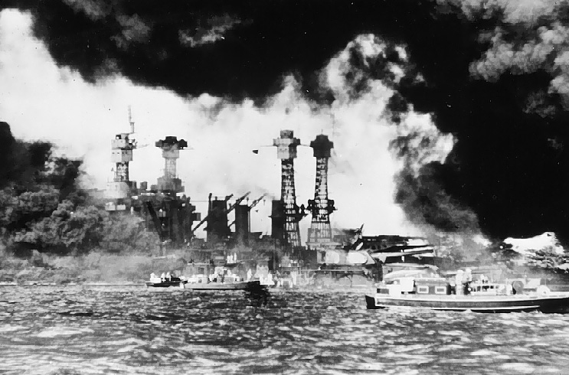
War in Asia
Japan had wanted to be a world power. They defeated china in 1895 and Russia in 1905. by 1933, Japanese empire had included Korea, Taiwan, Manchuria, and 3 islands in the pacific. But Japan was both economically and politically devastated.
The war in Asia began in July 1937 with the invasion of northern china. They occupied Indochina in 1941 so the United States cut off sales of vital scrap iron and oil to Japan. Reciprocating, Japan bombed American naval bases at Pearl Harbor, Hawaii. The next day, U.S. declared war on Japan, and 3 days later Hitler declared war on the U.S.
Japanese invaded the Dutch East Indies and occupied many islands in the Pacific Ocean.
The United States had joined with European nations and nationalist China in a combined effort to defeat Japan.

Slide 10
The Turning Point of the War (1942-1943)
Grand alliance: Allies Britain, United States and the Soviet Union.
The united states first priority was to defeat Germany. They increased the quantity of trucks, planes, and other arms that it sent to the British and Soviets. The Allies agreed to fight until the unconditional surrender of axis powers.
General Erwin Rommel with the Afrika Korps were able to break through British defenses in Egypt. Germans were also continuing their success in the battle of the North Atlantic as their submarines continued to attack allied ships carrying supplies to Great Britain.
British forces had stopped Rommel's troops in El Alamein. British and Americans had forced the German and Italian troops to surrender in French North Africa.
At Stalingrad, German forces were forced to surrender on February 2, 1943. They could not handle Russia's harsh winter. The entire German 6th army was lost. By the spring of 1943, Hitler knew that Germans would not defeat the Soviet Union.
The Battle of the Coral Sea, American naval forces stopped Japanese advance and relieved Australia of the threat of invasion. At the Battle of Midway Island, American planes destroyed all 4 of the attacking Japanese aircraft carriers and established American naval superiority in the Pacific.

Slide 11
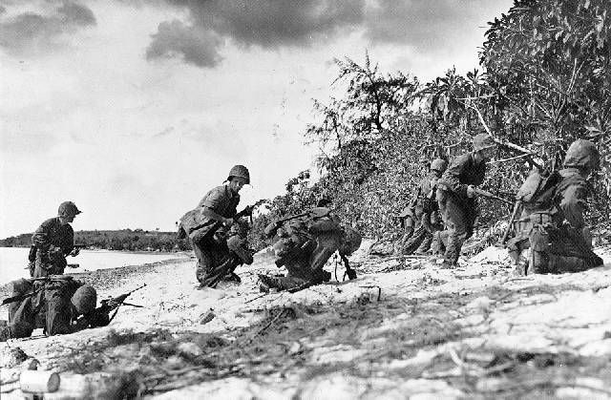
The Last Years of the War
Italians had surrendered when Mussolini was arrested and allies had begun invasion of mainland Italy.
Allies opened up their long awaited second front. They had been planning a cross-channel invasion of France from Britain. Under the direction of Dwight d. Eisenhower, allies landed 5 assault divisions on the beaches of Normandy. June 6th was history’s greatest naval invasion. 2 million men and half a million vehicles pushed past the German defensive lines.
Allies liberated Paris, and began for Germany but the battle of the bulge halted allied forces. They moved towards the Elbe River where they met up with the soviets.
German forces were defeated by the Soviets in the battle of Kursk, the greatest tank battle of ww2.
Hitler committed suicide two days after Mussolini was shot. On may 7,1945 German commanders surrendered.
President Harry Truman was given word that the atomic bomb had been tested successfully and it was ready for use against the Japs. They decided to drop the bomb on the cities of Hiroshima and Nagasaki. The Japanese surrendered unconditionally on august 14. world was 2 was finally over.
17 million died in battle and perhaps 18 million civilians perished as well.

Slide 12
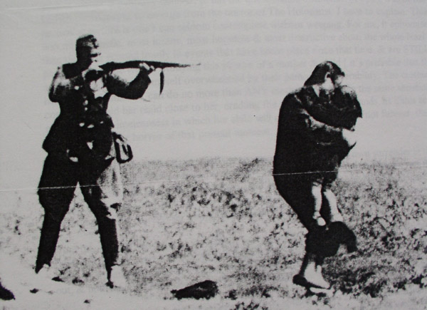
The Holocaust
The Nazis had fully believed in Aryan superiority. They believed that non-Aryans were inferior and trying to destroy the Aryans. This led to enslavement, ghettos, liquidation, then the mass genocide of all Jews and other groups. Ex) gypsies, homosexuals, disabled.
First Hitler focused on the emigration of German Jews from Germany. Then there was the Madagascar plan, in which Jews would be shipped to the island of Madagascar.
Heinrich Himmler and the SS shared these racial views and were put in charge of the Final Solution- annihilation of the Jewish people.
The Einsatzgruppen were ordered to round up all Polish Jews and concentrate them in ghettos established in a number of Polish cities.
They were then given a new order: round up Jews and execute and bury them in mass graves, often pits dug by themselves right before they were shot.

Slide 13
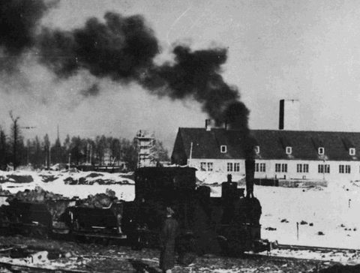
Continued…
Solving the Jewish problem was soon viewed as inadequate. Now a new plan was advised: death camps. Jews would be rounded up packed into freight trains, and shipped to Poland. The largest and most infamous was Aushwitz-Birkenau.
Medical technicians chose zyklon B (hydrogen cyanide) as the most effective gas for quickly killing large numbers of people in gas chambers designed to look like shower rooms. After gassing, the corpses would be burned in specially built crematoria.
Jews were being shipped from all countries occupied by Germany (or sympathetic to Germany).
The extermination was given priority of railroad cars even over desperate military needs.
About 30% of those sent to Auschwitz were sent to a labor camp; the rest were sent to the gas chambers. The victims’ goods were used for economic gain.

Slide 14
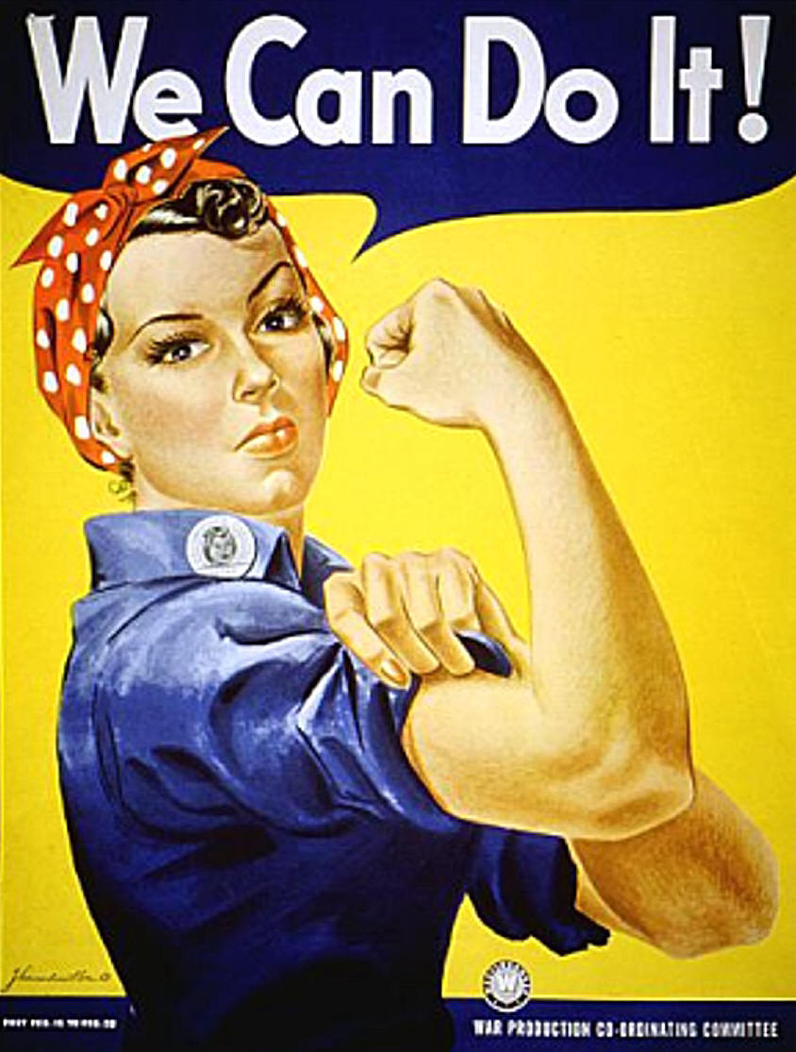
Total War
World War II was even more of a total war than World War I. Women were now needed in factories, seeing as men were off fighting. Almost every aspect of civilians lives were to do with the war.
Soviets allowed women in the military.
American women were not really needed, many small factories were being shut down due to overproduction.

Slide 15
The Frontline Civilians: the Bombing of Cities
Civilians were effected greatly during world war II. The use of bombs made it just as devastating as the frontline soldiers. British experienced this as German Luftwaffe tried to demolish their morale by bombing them. British also began bombing German cities in hopes of the same thing, resulting in a victory. Americans also had bombing strategies: daytime missions while British continued at nighttime.
Americans had successfully tested the A-bomb and used it against the Japanese in order to get them to surrender. The first was dropped on Hiroshima on August 6 and the second was dropped on Nagasaki on August 9. Around 450,000 people had perished.

Slide 16
The conferences at Tehran,
Yalta, and Potsdam
The Tehran Conference (EUREKA) was the meeting of Joseph Stalin, Franklin D. Roosevelt and Winston Churchill between November 28 and December 1, 1943, most of which were held at the Soviet Embassy in Tehran, Iran. It was the first World War II conference among the Big Three (the Soviet Union, the United States, and the United Kingdom) in which Stalin was present. The chief discussion was centered on the opening of a second front in Western Europe. The central aim of the conference was to plan the final strategy for the war against Nazi Germany and its allies.
The Yalta Conference, sometimes called the Crimea Conference and codenamed the Argonaut Conference, was the wartime meeting from February 4, 1945 to February 11, 1945 among the heads of government of the United States, the United Kingdom, and the Soviet Union—President Franklin D. Roosevelt, Prime Minister Winston Churchill, and Premier Josef Stalin, respectively—for the purpose of discussing Europe's postwar reorganization. Mainly, it was intended to discuss the re-establishment of the nations conquered by Germany.
The Potsdam Conference was held at Cecilienhof, in Potsdam, Germany from July 16 to August 2, 1945. The participants were the Soviet Union, the United Kingdom, and the United States. The three nations were represented by Communist Party General Secretary Joseph Stalin, Prime Minister Winston Churchill and later Clement Attlee, and President Harry S Truman. Stalin, Churchill, and Truman—as well as Attlee, who replaced Churchill as Prime Minister after the Labour Party's victory over the Conservatives in the 1945 general election—had gathered to decide how to administer the defeated Nazi Germany, which had agreed to unconditional surrender nine weeks earlier, on May 8 (V-E Day). The goals of the conference also included the establishment of post-war order, peace treaties issues, and countering the effects of war.

Slide 17
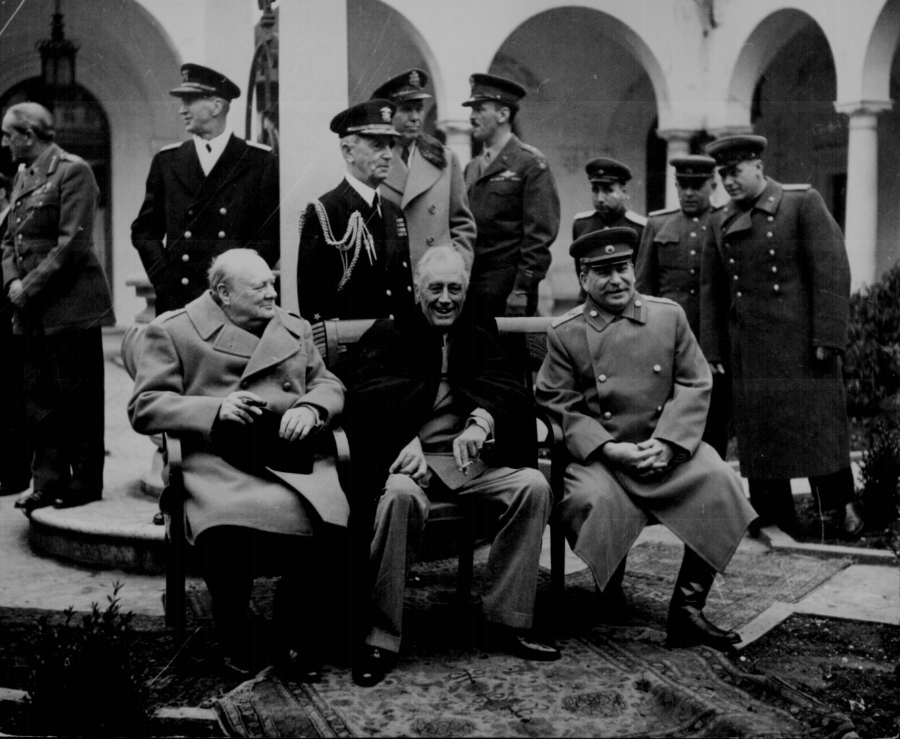
Continued…
At the conference of Potsdam, Truman had demanded that free elections were given throughout Eastern Europe. This is where he and Stalin had differed. It had become clear that Stalin was not going to stand by the post war decisions that were made at Yalta. This issue led to the mistrust of America towards communist Soviet Union.
Winston Churchill declared that an “iron curtain” had descended across the continent.

Slide 18
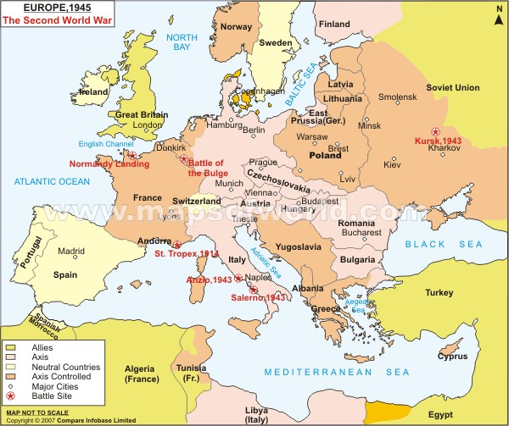

Slide 19
Review
1) Who were the big three?
Hitler, Tojo, Stalin
Roosevelt, Stalin, Churchill
Chamberlain, Mussolini, Truman
2) Post war actions were discussed at which conference?
Yalta
Tehran
Potsdam
3)Where did the Japanese attack Americans?
Pearl Harbor
New York
California
4) All of the following were considered non-Aryans except:
Jews
Gypsies
Women
Homosexuals
What was the pact between Hitler and Stalin called?
non-aggression pact
Anti-COM intern pact
isolationism

