Slide 1
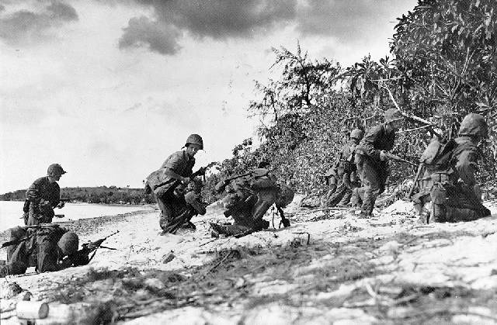
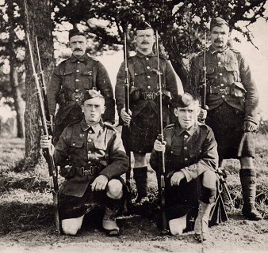
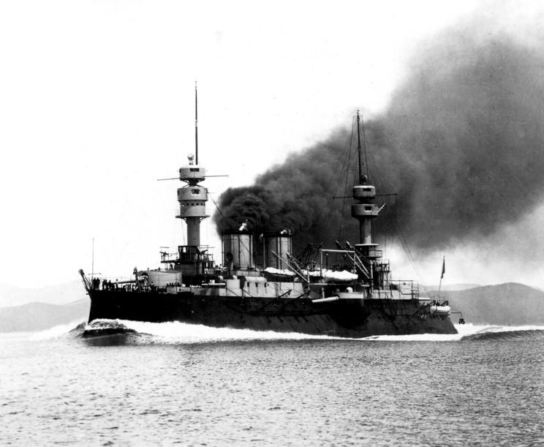
WAR AND REVOLUTION
1914-1919

Slide 2
Outline
The Road to World War I
The War
War and Revolution
The Peace Settlement
Conclusion

Slide 3
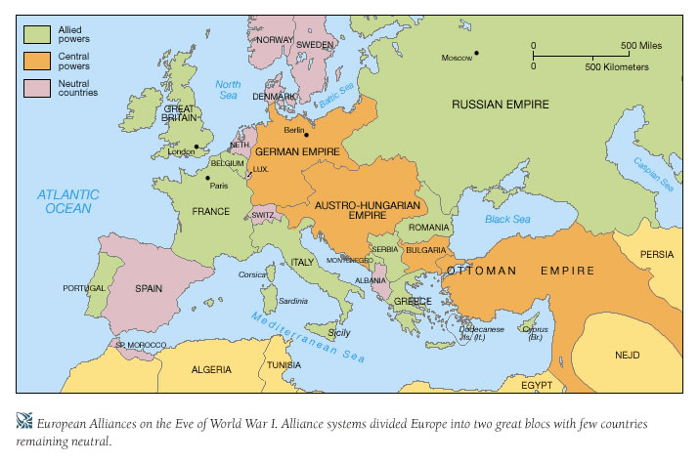
WHAT, WHERE, WHEN, WHY
1914
June 28, 1914, Archduke Francis Ferdinand (from Austria) was assassinated in the Bosnian city of Sarajevo, Serbia.
Slavic minorities in the Balkans still dreamed of creating their own national state.
Nationalism, militarism and internal dissent.
System of nation-states that had emerged in Europe in the second-half of the nineteenth century led not to cooperation but to competition. Rivalries over colonial and commercial interests intensified during an era of frenzied imperialist expansion, and the creation of two loose alliances (Germany, Austria and Italy, and France, Great Britain and Russia).
Europe in 1914. By this time, Russia sought to bolster fellows Slavs in Serbia, whereas Austria-Hungary was intent on increasing its power in the Balkans and thwarting Serbia’s ambitions.

Slide 4
Chronology
Assassination of Archduke Francis Ferdinand June 28
Austria’s ultimatum to Serbia July 23
Austria declares war on Serbia July 28
Russia mobilizes July 29
German ultimatum to Russia July 31
Germany declares war on Russia August 1
Germany declares war on France August 3
German troops invade Belgium August 4
Great Britain declares war on Germany August 4

Slide 5
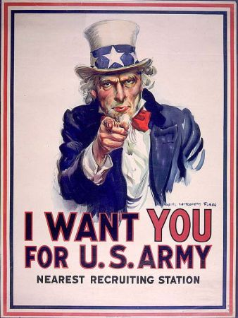
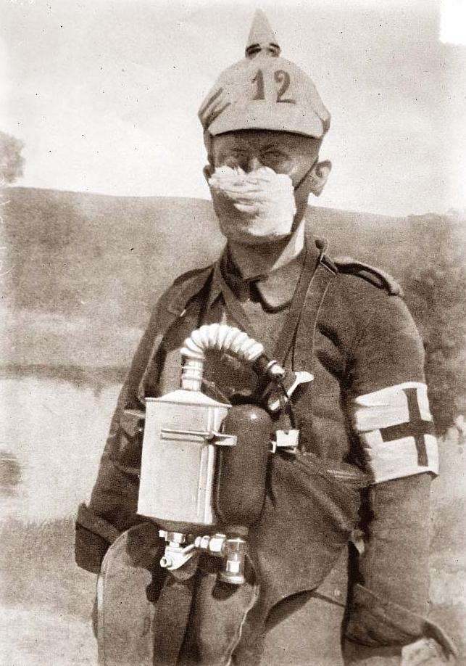
"Speak softly and carry a big stick; you will go far.”
- Theodore Roosevelt, April 1903

Slide 6
The excitement of War
Social
Government propaganda had been successful stirring up national antagonist before the war.
Many people thought the Great War was going to be short and it was rightful.
- It gave release from humdrum bourgeois existence.
Millions abandoned their petty preoccupations with material life , riding the nation of selfishness and sparking a national rebirth based on self-sacrifice, heroism, and nobility.
It brought an end to unemployment for all the social classes.
The enthusiastic patriotism of workers was soon rewarded with a greater acceptance of trade unions.
Women were called on to take over jobs and responsibilities that had not been open to them before.
French government passed a law in July 1915 that established a minimum wage for women.
Also women gained the right to vote in countries such as Germany, Austria and Britain after the war.

Slide 7
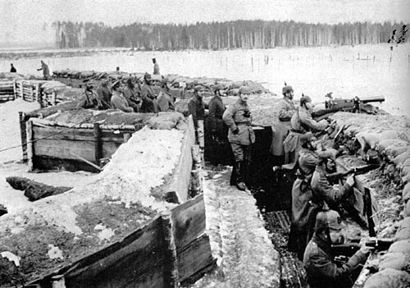
Political
Domestic differences were temporarily shelved in the midst of war fever at the beginning.
As the Great War dragged on and both casualties and privations worsened, internal dissatisfaction replaced the patriotic enthusiasm.
In 1916-17, liberals and socialists came in conflict.
Liberals in both Germany and Britain sponsored peace resolutions.
Czech leaders in the Austrian Empire openly called for an independent democratic Czech state.
War governments tried to fight against the oppositions too, leading to authoritarian states to rely on force to subdue their population .
Countries now sought for revolutions to stop the war, and so forth.
Revolution in Russia
The revolutions in Russia in 1917, destroyed the Tsarist autocracy and led to the creation of the Soviet Union.
In the first revolution in February 1917, the Czar was deposed and replaced with the Provisional government, and in the second revolution in October the Provisional Government was removed and replaced with a Bolshevik (Communist) government.

Slide 8
Chronology Russian Revolution
March of women in Petrograd March 8
General strike in Petrograd March 10
Establishment of provisional government March 15
Tsar abdicates March 15
Formation of Petrograd soviet March
Lenin arrives in Russia April 3
Lenin’s “April Theses” April 20
Failed attempt to overthrow provisional government July
Bolsheviks gain majority in Petrograd Soviet October
Bolsheviks overthrow provisional government Nov 6-7
Lenin disbands Constituent Assembly January 1918
Treaty of Brest-Litovks March 3
Civil War 1918-1921

Slide 9
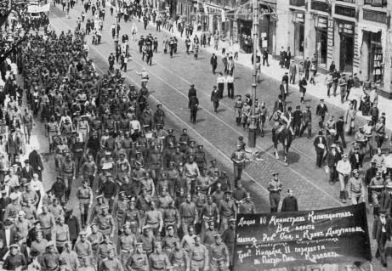
The Woman’s March in Petrograd
After the imposition of bread rationing in Petrograd, ten thousand women engaged in mass demonstrations and demanded “Peace and Bread” for the families of soldiers. This photograph shows the women marching through the streets of Petrograd in March 8, 1917.

Slide 10
Economic
Economic problems faced as the war went on because it was thought the war would be short.
Free market capitalistic systems were temporarily shelved as governments experimented with price, wage, and rent controls, the rationing of food supplies, and materials.
Some governments moved into compulsive employment.
Germany had the most success in developing a planned economy.
Great Britain tired to continue the war by sticking to its tradition of limited government interference in the economy.
The Ministry of Munitions took numerous steps to ensure that private industry would produce was materiel at limited profits. Some governments moved into compulsive employment.
The autocratic empires of Russia, and Austria-Hungary had backward economies that proved incapable of turning out the quantity of war materiel needed to fight a modern war.

Slide 11
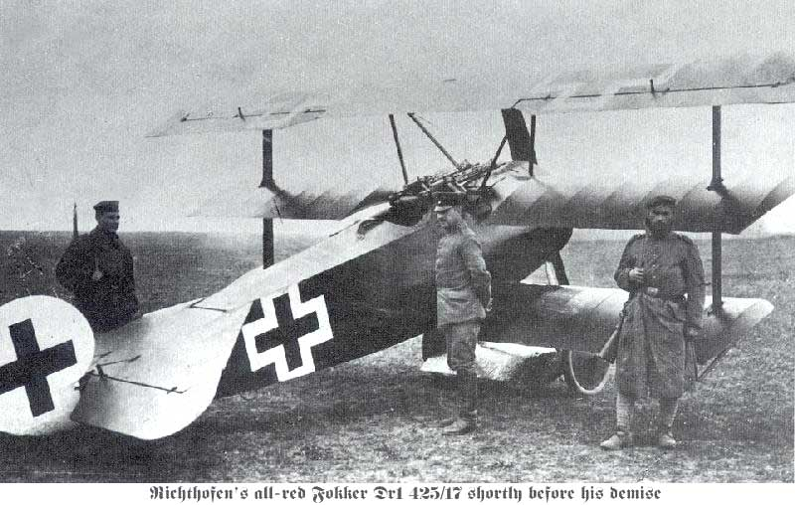
Technological
The technology reflected a trend toward industrialism and the application of mass production methods to weapons and to the technology of warfare in general.
innovations included bolt-action infantry rifles, rifled artillery and hydraulic recoil mechanisms, zigzag trenches and machine guns, and their application had the effect of making it difficult or nearly impossible to cross defended ground.
Poison gas was created.
Early war aircraft were not much different in design from the original Wright Flyer, which made its first flight over a decade earlier. they soon began firing at each other with handheld weapons and even throwing spears.
Naval Warfare dominated by Great Britain.
Propaganda led to technological advantages in mass production.

Slide 12
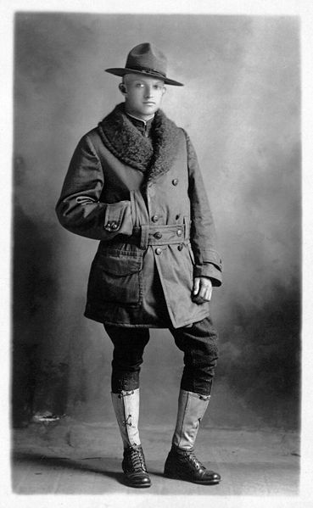
Entry of the United States
The United States originally pursued a policy of isolationism, avoiding conflict while trying to broker a peace.
When a German U-boat sank the British liner Lusitania in 1915, with 128 Americans aboard, U.S. President Woodrow Wilson vowed, "America is too proud to fight" and demanded an end to attacks on passenger ships. Germany complied.
After the British revealed the Zimmerman telegram to the United States, President Wilson, released the captured telegram as a way of building support for U.S. entry into the war.
United States declared war on Germany on 6 April 1917.

Slide 13
Chronology World War I
Battle of Tannenberg August 26 1914
Battle of Gallipoli begins April 25, 1915
Italy declares war on Austria-Hungary May 23
Battle of Verdun Feb-Dec 1916
Germany returns to unrestricted submarine warfare Jan 1917
United States enter the war April 6
The Champagne offensive April 16-29
Allied counteroffensive Jul-Nov 1918
Armistice between Allies and Germany Nov 11
Paris Peace Conference begins January 18
Peace of Versailles June 28

Slide 14
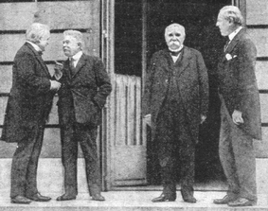
The Big Four at Paris
Shown here are the Big Four at the Paris Peace Conference: David Lloyd George of Britain, Vittorio Orlando of Italy, Georges Clemenceau of France, and Woodrow Wilson of the United States.

Slide 15
Peace Settlements Treaty of Versailles
Versailles ended the state of war between Germany and the Allied Powers. It was signed on 28 June 1919.
It required Germany to accept sole responsibility for causing the war and, under the War Guilt clauses, to disarm, make substantial territorial concessions and pay reparations to certain countries that had formed the Entente powers. Some governments moved into compulsive employment.
The Treaty of Saint-German and The Treaty of Trianon divided Austria-Hungary, largely along ethnic lines, into several successor states including Austria, Hungary, Czechoslovakia, and Yugoslavia.

Slide 16
Legacy
The rich industrial nations of the world developed destructive technology and used it in ways that came close to destroying the earth.
The League of Nations was created to help keep peace, and instantaneous communication allows people to understand what is happening throughout the world.
It freed some countries out of the empires already created before the war.

Slide 17
Conclusion
World War I ended the age of European hegemony over world affairs. In 1917, the Russian Revolution laid the foundation for the creation of a new Eurasian power The Soviet Union. These developments, though temporary, created a political vacuum in Europe that all too soon was filled by the revival of German power.

Slide 18
Multiple Choice
The immediate cause of World War I was:
An uprising of peasants in Catholic Bavaria.
The assassination of Archduke Francis Ferdinand.
The German invasion of Poland.
As public morale weakened in the later stages of the war:
Workers’ strikes lessened because of brutal suppression
Clemenceau’s liberal French government let internal dissent dictate government policy
Propaganda posters lost all meaning and were abandoned.
Police officers were expanded to include the arrest of dissenters as traitors.
The most visible effect of World War I on British society was
Lessening of class distinctions
Lessening of criminal behavior
Dramatic increase in church membership and attendance
New optimistic, positive outlook on the part of young people
The Second Battle of the Marne was:
Germany's final effort to win the war
The decisive victory Germany had hoped to win
A disaster for the Allies
All of the above
At the Paris Peace Conference, Clemenceau of France wanted Germany to:
Be demilitarized
Pay heavy reparations
Both A and B
Neither A nor B

