Slide 1
Chapter Twenty One 1815-1850
Reaction, Revolution,
and
Romanticism
Lauren Genta

Slide 2
Political: Conservative Order (1815-1830)
Congress of Vienna
Led by Austrian Prime Minister, Prince Klemens von Metternich
Principle of Legitimacy : to reestablish peace and stability in Europe he considered it necessary to restore the legitimate monarchs who would preserve the traditional institutions
Restoration of the Bourbons in France and Spain; many rulers returned to thrones in Italy; Prussia and Austria allowed to keep some Polish territory
new nominally independent Polish kingdom was established with Romanov dynasty as its hereditary monarchs- gained independence but foreign policy under Russian control
France’s borders returned to those of 1790, forced to pay an indemnity and accept army of occupation for 5 yrs

Slide 3
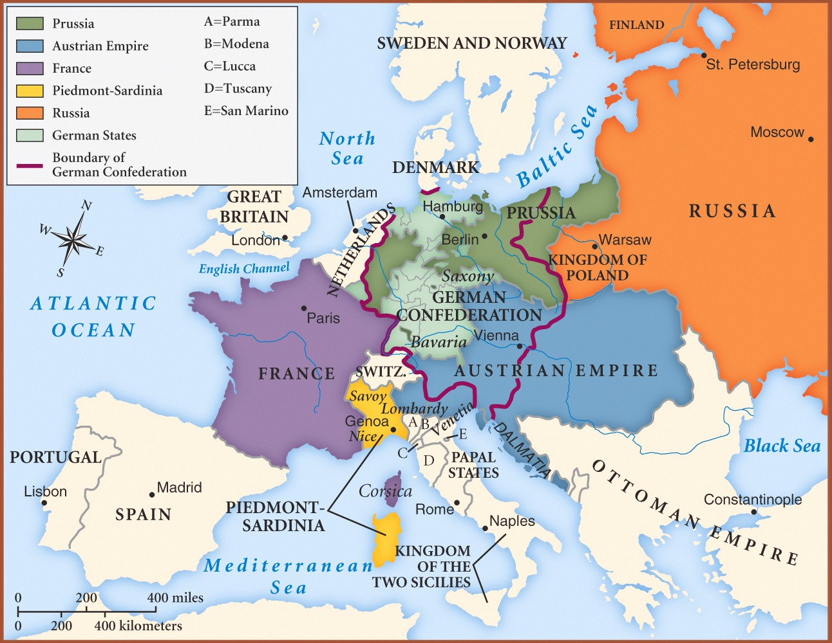
Map of Europe: Post Congress of Vienna

Slide 4
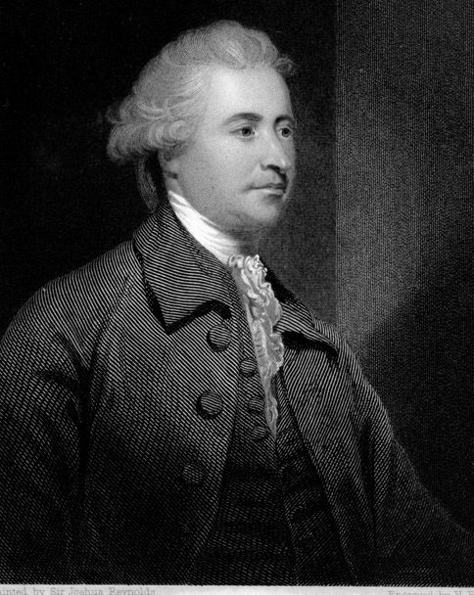
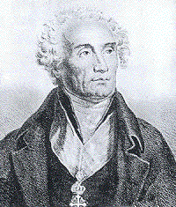
Ideology of Conservatism
Edmund Burke’s Reflections on the Revolution in France (1790) as a guide; the state as a partnership and each generation has the duty to preserve, transmit to the next
Joseph de Maistre- spokesman for counterrevolutionary and authoritarian conservatism; only absolute monarchy could guarantee “order in society” and avoid chaos
Favored obedience to political authority, organized religion was crucial to social order, hated revolutionary upheavals
Supported by hereditary monarchs, gov’t bureaucracies, landowning aristocracies, revived churches
Joseph de Maistre
Edmund Burke

Slide 5
The Concert of Europe
4 postwar conferences between 1818 and 1822.
Aix-la-Chapelle- troops withdrawn from France who joins making a quintuple alliance
Troppau- outbreaks of revolution in Spain and Italy, principals of intervention
Laibach- authorize Prussian troops to Naples, restores Ferdinand I to throne
Verona- authorize French troops to Spain, Ferdinand VII & Bourbon monarch restored
Breaks down after Great Britain rejects principles of intervention
Revolts in Latin America
Simon Bolivar struggled for independence in Venezuela; Jose de San Martin freed Chile in 1817, and then moved onto Lima; Mexico and Central American provinces achieved their freedom, Portugal recognizes independence of Brazil; by 1825 almost all of Latin America had been freed of colonial domination
British proposed joint action with the U.S. against European interference in Latin America
Monroe Doctrine (1823) guaranteed Latin America’s independence and warns against any further European intervention
Greek Revolt
1821, Greeks revolt against Ottoman Turkish masters, outpour of European sentiment
Treaty of Adrianople (1821) ended Russian-Turkish war; Ottoman Empire agrees to allow Russia, France, and Britain decide the fate of Greece
Greece declared an independent nation and later a new royal dynasty is established

Slide 6
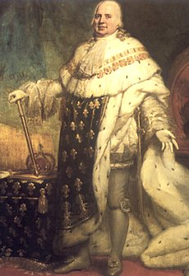
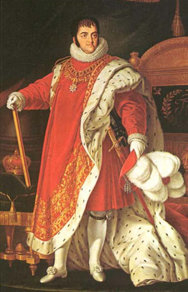
Rule of the Tories in Great Britain
Corn Laws of 1815 as response to falling agriculture prices places very high tariffs on foreign grain; benefits landowners, very difficult for middle and working class
Mass protest like the Peterloo Massacre; 11 die; leads Parliament to take more repressive measures
Restoration in France
1814- Bourbon restoration with Louis XVIII; bicameral Chamber of Peers and Deputies
Ultraroyalists hope to return to monarchial system, restore influential Catholic church
1824- Charles X encourages Catholic church to reestablish control, accept principal of ministerial responsibility
Intervention in Italy & Spain
Italy under Austrian domination; reactionary gov’t; Carbonari plan for revolution
Ferdinand VII; liberal constitution leads to revolts; French intervene & restore monarch
Restoration
Of the
Bourbons

Slide 7
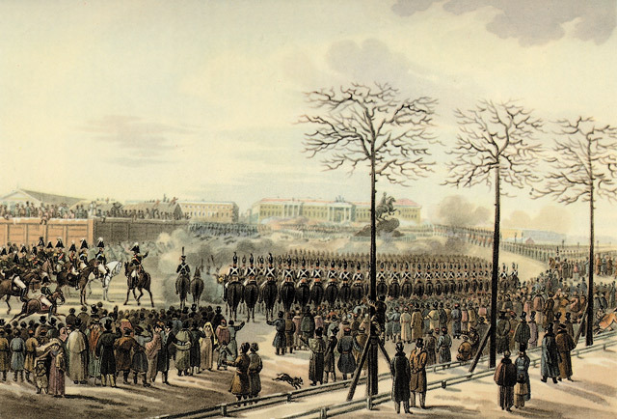
Repression in Central Europe
Burschenschaften: student societies dedicated to fostering the goal of a free united Germany; motto “Honor, Liberty, and Fatherland” in part inspired by Friedrich Ludwig Jahn
Metternich declares the Karlsbad Decrees of 1819 which close the Burschenschaften, provide for censorship of the press, and place the universities under close supervision and control
Austrian Empire held together by the dynasty, the imperial civil service, the imperial army, and the Catholic Church
Forces of liberalism and nationalism grew causing the Austrian Empire to stagnate
Tsarist Autocracy in Russia
Alexander I dies leaves throne to his brother Nicholas instead of Constantine, its legal heir
The Decembrist Revolt (1825)- military leaders of Northern Union rebelled against accesion of Nicholas; soon crushed by troops loyal to Nicholas and its leaders were executed
Nicholas I transforms from a conservative into a reactionary; strengthened both the bureaucracy and secret police; Third section given sweeping power

Slide 8
Intellectual: Ideologies of Change
Liberalism
Belief: people should be as free from restraint as possible; Gov’t involved in 3 functions: the defense of the country, police protection of individuals, construction and maintenance of public works too expensive for individuals to undertake
Tied to middle-class men (esp. industrials) who favored the extension of voting rights to share power with landowning class
Most influential are Thomas Malthus Essay on the Principles of Population; David Ricardo Principles of Political Economy; John Stuart Mill On Liberty and On the Subjection of Women which argued “the legal subordination of one sex to the other” was wrong
Nationalism
Belief: the awareness of being part of a community that has common institutions, traditions, languages, and customs should become the focus of the individual’s primary political loyalty
Early Socialism
Belief: to introduce equality into social conditions and believed that human cooperation was superior to the competition that characterized early industrial capitalism
Early socialist sought to demonstrate the advantages of cooperative living in phalansteries or utopian environments

Slide 9
Social: Revolution and Reform (1830-1850)
July Revolution in France
1830- Charles X issues the July Ordinances that imposed rigid censorship on the press, dissolved the legislative assembly, and reduced the electorate in preparation for new elections; liberalism plays major role and he is overthrown
1830’s Outbursts in Belgium, Poland, and Italy
Belgians rise up against the Dutch and succeeded in convincing the major European powers to accept an independent, neutral Belgium; Leopold of Saxe-Coburg becomes new king; Belgian national congress establishes a constitutional monarchy
Metternich sends Austrian troops to crush revolts in 3 Italian states
Polish revolutionaries try to end Russian control of their country ; fail and Russians establish an oppressive military dictatorship
Reform in Britain
The Reform Act of 1832 gave industrial urban communities some voice in gov’t; benefits upper-middle class
The Poor Law of 183 4made pauper so wretched they would choose to work
The Repeal of the Corn Laws in 1846 abolished the Corn Laws, aided the industrial middle class, economic liberals that favored the principles of free trade

Slide 11
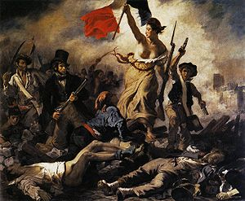
Revolutions of 1848
Opposition grows as Louis-Philippe continually refuses to make reforms; abdicates throne; provisional gov’t established under influence of Louis Blanc; “June Days” revolt
New Constitution ratified in Nov. 1848, establishes the Second Republic in which universal male suffrage votes in a unicameral legislature for 3 yrs & a president for 4 yrs, Charles Louis Napoleon Bonaparte wins
King Frederick William IV agreed to abolish censorship establish a new constitution, and work for a united Germany; leads to an assembly of the German liberals at Frankfurt which fails to create a unified German state
Hungarian liberals start demonstrations that lead to Metternich’s dismissal, their only tie becomes allegiance to the Hapsburgs; rebels in the empire had been crushed and in December Ferdinand I agreed to abdicate for his nephew Francis Joseph I , Nicholas I intervened to aid the Austrians and finally crushed the revolution
Dreams of Italian unification by Manzinzi and Belgioioso; rebellions spread as rulers grant constitutions and others rebel against Austrian overlords

Slide 12
Social & Economic: Emergence of an Ordered Society
New Police Forces
France 1829- In March, serjents on Paris streets, 85 by August, 500 in 1850, and 4,000 by the end of the century
England 1829-1830- Between September and May 3,000 uniformed police officers appeared in London, known as bobbies after Sir Robert Peel
Germany 1848- State-financed Schutzmannschaft was modeled after London police was established in Berlin after the revolutions of 1848; began as a civilian body but b 1851 organized for military lines and used for political purposes
Attacks on Poverty
European states passed poor laws that attempted to force paupers to find work on their own or enter workhouses; belief that poverty was a result of moral degeneracy of the lower classes called the “dangerous classes”
Prison Reform
Geared toward the creation of a more disciplined society
Walnut Street Prison model in which separate cells isolate prisoners
Petite Roquette and Pentonville, prisoners wore leather masks while they exercised and sat in separate stalls when in chapel
Solitary confinement forced prisoners back on their own consciences, led to greater remorse, increased possibility they would changer their evil ways

Slide 13
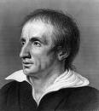
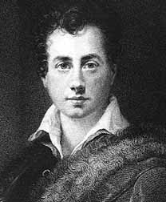
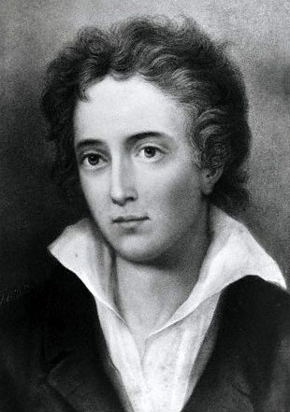
Social: Romantic & Gothic
Characteristics of Romanticism
Emphasize emotion, sentiment, and inner feelings
Intense love of nature
Tragic figure; stress on the heroic
Passionate interest in the pass
Attraction to the bizarre and unusual
Pursuing extraordinary states of experience in dreams, nightmares, frenzies, suicidal depression,
Experiment with cocaine, opium, hashish to produce altered states of consciousness
Romantic Poets & Gothic Literature
Poetry ranks above all forms as it was a direct expression of one’s soul
Nature served as a mirror into which humans could look to learn about themselves; alive and sacred; some identified nature with God; Wordsworth, Shelley, Lord Byron
Let poets to critique the mechanistic materialism of science
German Romantic school of mystery and horror is the nature of Gothic literature; Poe, Mary Shelley
Wordworth, Shelley, Byron

Slide 14
Romanticism in Art
2 fundamental beliefs: All artistic expression to artists was a reflection of the artists inner feelings & a painting should mirror the artists vision of the world and be the instrument of his own imagination
Caspar David Friedrich- preoccupation with God and nature; painted landscapes that conveyed a feeling of mystery and mysticism, nature as a manifestation of divine life
Malford William Turner- sought to convey the moods of nature by using light and color to suggest natural effects; “airy visions painted with tinted steam”
Eugene Delacroix- most famous Romantic painter; fascinated by the exotic; combined theatricality and movement with a daring use of color

Slide 15
Music: The Most Romantic of the Arts
Enabled the composer to probe deeply into human emotions
Era more of a bridge between Classicism and Romanticism
Beethoven- studied under Haydn; Eroica broke through to the elements of Romanticism with his use of uncontrolled rhythms to create dramatic struggle and uplifted resolutions; Ninth Symphony composed when he was completely deaf
program music -attempt to use the moods and sound effects of instrumental music to depict the actions and emotions inherent in a story, event, or personal experience
Hector Berlioz- one of the founders of program music, famous Symphonie Fantastique evokes emotions of a tortured love affair

Slide 16
Religious: Revival in the Age of Romanticism
Christianity & Catholicism
Restoration of the nobility brought a new appreciation for the Catholic faith as a force for order in society which was greatly enforced by the Romantic movement and the emphasis on emotion
Catholicism echoed the Harmony of all things
Protestantism
Began in the 18th century with the enthusiastic emotional experiences of Methodism in Britain and Pietism in Germany
Missionaries from England & Scotland carried messages to liberal Protestant churches in France and Switzerland
Evangelical preachers found their messages of hellfire and the method of emotional conversion evoked a ready response among Germans alienated by the highly educated clergy of the state churches

