Slide 1
The Age of Nationalism and Realism
By: Kayla Kashi

Slide 2
The Crimean War [1854-1856]
also known in Russia as the Oriental War (October 1853–February 1856) was fought between the Russian Empire on one side and an alliance of France, the United Kingdom, the Kingdom of Sardinia, and the Ottoman Empire on the other. The war was part of a long-running contest between the major European powers for influence over territories of the declining Ottoman Empire. Most of the conflict took place on the Crimean Peninsula, with additional actions occurring in western Turkey and the Baltic Sea region.

Slide 3
Crimean War

Slide 4
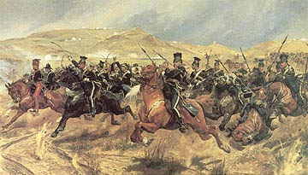
The Charge of the Light Brigade: The Battle of Balaklava [1854]
was a disastrous charge of British cavalry led by Lord Cardigan against Russian forces during the Battle of Balaclava on 25 October 1854 in the Crimean War. It is best remembered as the subject of a famous poem entitled The Charge of the Light Brigade by Alfred, Lord Tennyson, whose lines have made the charge a symbol of warfare at both its most courageous and its most tragic.

Slide 5
Treaty of Paris
settled the Crimean War between Russia and an alliance of the Ottoman Empire, the Kingdom of Sardinia, France, and the United Kingdom. The treaty, signed on March 30, 1856, made the Black Sea neutral territory, closing it to all warships, and prohibiting fortifications and the presence of armaments on its shores. The treaty marked a severe setback to Russian influence in the region.

Slide 6
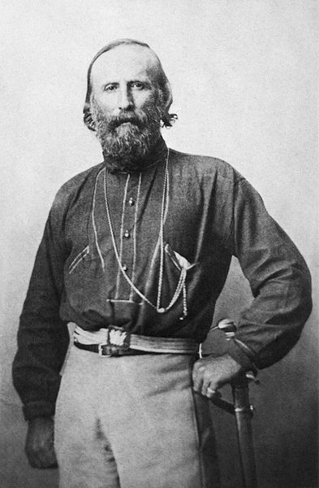
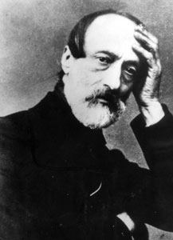
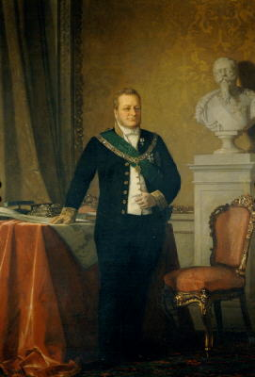
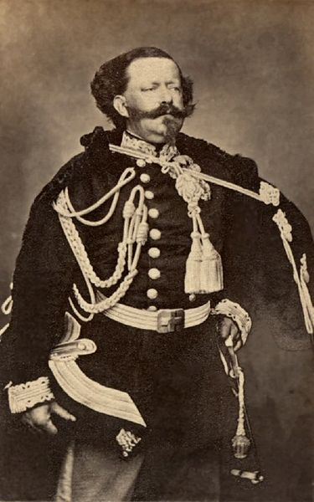
Italian Unification
Major Players
Count Cavour Giuseppi Garibaldi Giuseppi Mazzini
King Victor Emmanuel II

Slide 7
Garibaldi Defends Rome Against the French, (April 30, 1849)
On April 30, 1849 the Republican army, under the command of Garibaldi, defeated a numerically far superior French army. Subsequently, additional French reinforcements arrived and the siege of Rome began on June 1. Despite the resistance of the Republican army, led by Garibaldi, the French prevailed on June 29. On June 30 the Roman Assembly met and debated three options: to surrender; to continue fighting in the streets of Rome; to retreat from Rome and continue the resistance from the Apennine mountains. Garibaldi made a speech in which he favored the third option and then said:

Slide 8
Dovunque saremo, colà sarà Roma. (Wherever we may be, there will be Rome).

Slide 9
Sardinia-Piedmont:
Italian unification movement:
Risorgimento [“Resurgence”]
The leader of the 1821 revolutionary movement in Piedmont was Santorre di Santarosa, who wanted to remove the Austrians and unify Italy under the House of Savoy. The Piedmont revolt started in Alessandria, where troops adopted the green, white and red tricolore of the Cisalpine Republic. The king's regent, prince Charles Albert, acting while the king Charles Felix was away, approved a new constitution to appease the revolutionaries, but when the king returned he disavowed the constitution and requested assistance from the Holy Alliance. Di Santarosa's troops were defeated, and the would-be Piedmontese revolutionary fled to Paris.

Slide 10
Carbonari Insurrections: 1820-1821
They were organized in the fashion of Freemasonry, broken into small cells scattered across Italy. They sought the creation of a liberal, unified Italy.
The membership was separated into two classes—apprentice and master. There were two ways to become a master, through serving as an apprentice for at least six months or by being a Freemason on entry. Their initiation rituals were structured around the trade of charcoal-selling, hence their name.

Slide 11
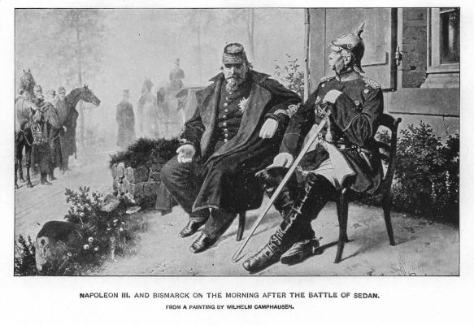
Cavour & Napoleon III Meet at Plombières, 1858
The plan involves the goading of Austria into a war with Piedmont that France will then enter as the Italian state's ally. In return, the French are to increase their influence with the Pope and gain areas in south-west Italy, including Nice. Though not all will go according to plan, the war will arrive and France and Piedmont will defeat Austria and France will receive its new territories.

Slide 12
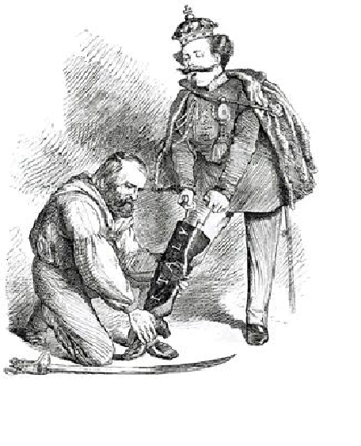
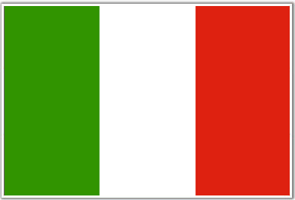
Kingdom of Italy 1871
A contemporary British cartoon, entitled "Right Leg in the Boot at Last," shows Garibaldi helping Victor Emmanuel put on the Italian boot.

Slide 13
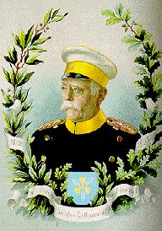
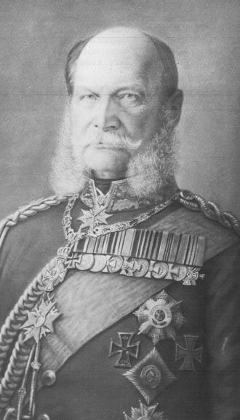
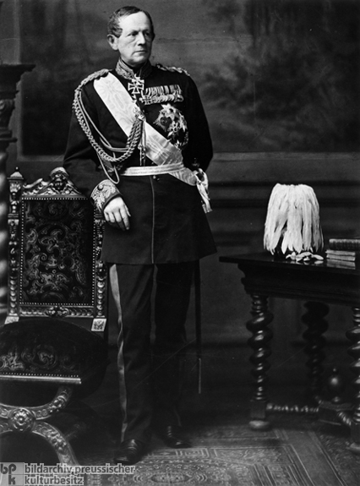
Unification Of Germany
Majors Players
Kaiser Wilhelm I Helmut von Moltke Otto Von Bismark

Slide 14
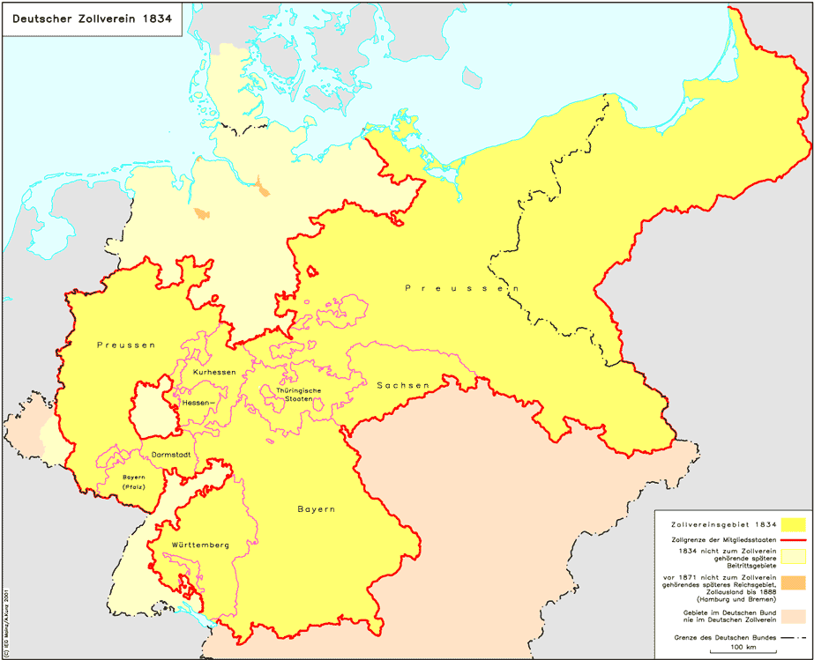
Zollverein
German Customs Union was formed among the majority of the states of the German Confederation in 1834 during the Industrial Revolution to remove internal customs barriers, although upholding a protectionist tariff system with foreign trade partners. The main ideological contributor behind the customs union was Friedrich List, an economist holding mercantilist and protectionist views. The Zollverein excluded Austria because of its highly protected industry; this economic exclusion would later exacerbate the Austro-Prussian rivalry for dominance in central Europe during the late 19th century. The Zollverein was effectively ended in 1866 with outbreak of the Austro-Prussian War a new organization with the same name was brought about in 1867 when peace was restored. The new Zollverein was stronger, in that no individual state had a veto.

Slide 15
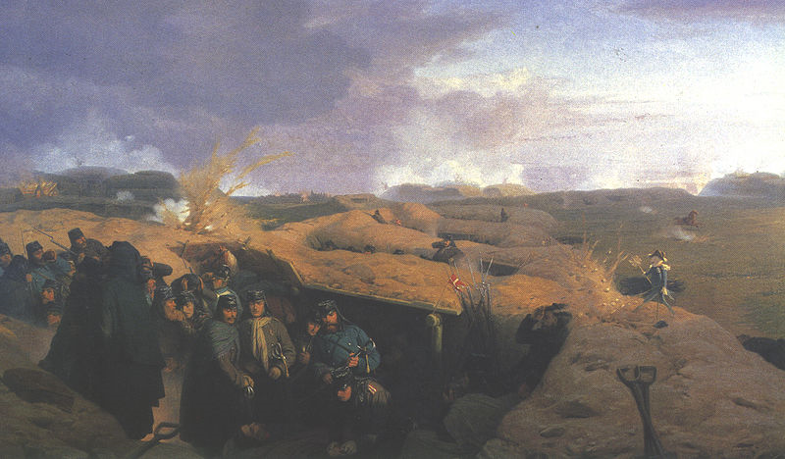
The Danish War
was the second military conflict due to the Schleswig-Holstein Question. The war began on February 1, 1864 when Prussian forces crossed the border into Schleswig.
The war was fought between Denmark on the one side and Prussia and Austria on the other side. Like the First Schleswig War (1848–51), it was fought for control of the duchies because of succession disputes concerning the duchies of Holstein and Lauenburg when the Danish king died without an heir acceptable to the German Confederation

Slide 16
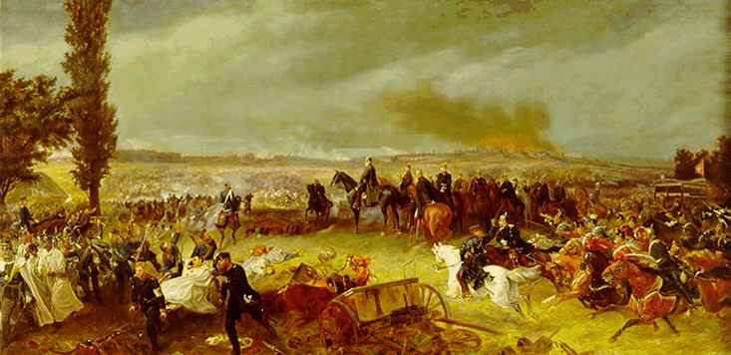
Austro-Prussian War
Seven Weeks War, the Unification War or the German Civil War) was a war fought in 1866 between the Austrian Empire and its German allies on one side and the Kingdom of Prussia with its German allies and Italy on the other, that resulted in Prussian dominance over the German states. In Germany and Austria, it is also the In the Italian unification process, this is called the Third Independence War.

Slide 17
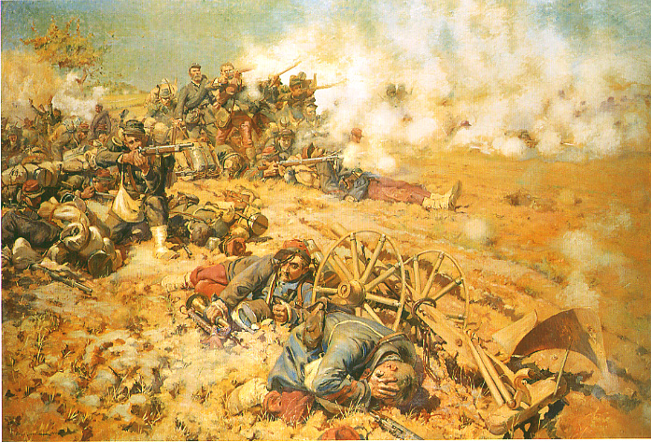
The Franco-Prussian War
was a conflict between France and Prussia, while Prussia was backed by the North German Confederation, of which it was a member, and the South German states of Baden, Württemberg and Bavaria. The complete Prussian and German victory brought about the final unification of the German Empire under King Wilhelm I of Prussia. It also marked the downfall of Napoleon III and the end of the Second French Empire, which was replaced by the Third Republic. As part of the settlement, almost all of the territory of Alsace-Lorraine was taken by Prussia to become a part of Germany, which it would retain until the end of World War I.

Slide 18
German Empire
The Franco-Prussian war confirmed Prussia as the dominant player in a unified German state and, with the symbolic proclamation of Wilhelm as Kaiser, Prussia assumed the leadership of the new empire. The southern states became officially incorporated into a unified Germany at the Treaty of Versailles of 1871 (26 February 1871; later ratified in the Treaty of Frankfurt of 10 May 1871), which ended the Franco-Prussian War. Bismarck, as the first chancellor of a unified Germany, had led the transformation of Germany from a loose confederation to a federal nation state. But he had not done it alone. Unification occurred by building on a tradition of legal collaboration under the Holy Roman Empire and economic collaboration through the Zollverein. The difficulties of the Vormärz, the impact of the 1848 liberals, the importance of von Roon's military reorganization, and Moltke's strategic brilliance, all played a part in political unification.

Slide 19
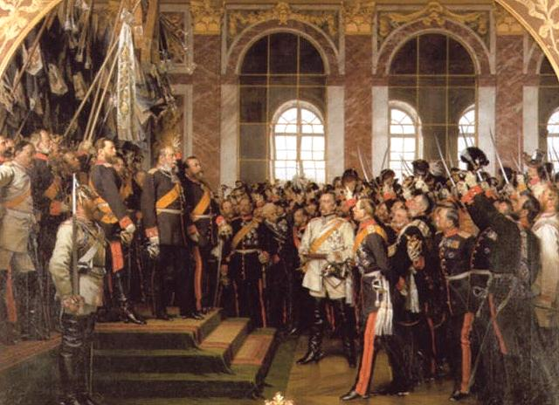
Bismarck achieved German unity largely through three military successes: the Second War of Schleswig (1864), the Austro-Prussian War (1866), and the Franco-Prussian War (1870–71). But unifying various states into one nation required more than some military victories, as important as these might have been for morale and public relations. It also required a rethinking of political, social and cultural behaviors, and the construction of new metaphors about "us" and "them".
Who were the new members of this new nation? What did they stand for? How were they organized?

Slide 20
Multiple Choice Questions
An overall result of the Crimean War was:
The reinforcement of the concert of Europe until 1914
Russian expansion into Europe for the next two decades
Increased British involvement in continental affairs
An international climate in which both Italian and German unification were possible
Before administration of Otto von Bismark, Prussia was characterized by a:
Deteriorating army under William I
System of voting determined by wealth
Resentful middle class with no voice in the lower house of the legislature
Parliament without power to reject the king
A result of Bismark’s Austro-Prussian war was:
Austria’s annexation into the North German Confederation
The reduction of Austria to a second-rate power
Liberal Prussian condemnation of Bismark’s expansionist policies
all or none of the above
The immediate cause of the Franco-Prussian War Was:
The ascent of a French prince to the Spanish throne
A Bismark edited telegram from King William I
The French invasion of Alsace-Lorraine
Napoleon III’s annexation to Schleswig-Holstein

