Slide 1
The Mass Society in an “Age of Progress”
1874-1894

Slide 2
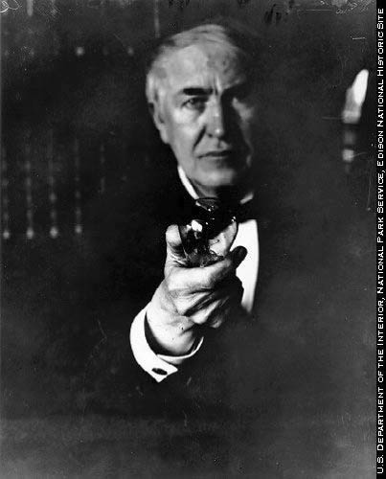
The Second Industrial Revolution
New Products
Steel replaced Iron
Internal Combustion Engine
Led to development of automobiles, and flight
Electricity facilitated more inventions and better factories
Telephone, light bulbs, conveyer belts, etc.

Slide 3
New Markets
after 1870, foreign markets were saturated, so there was a renewed interest in domestic markets
Rise in real wages and national incomes
Europeans could spend more on consumer goods
Dramatic population increase
Protective tariffs implemented to guarantee domestic markets
Cartels formed to decrease competition
Streamline productions
Cutting labor costs by introducing more machinery

Slide 4
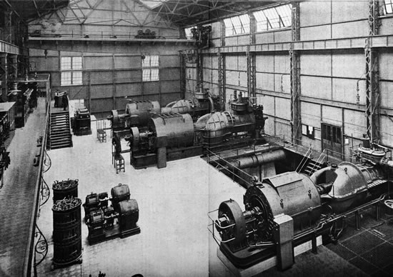
New Economic Patterns
After 1870, Germany replaced Great Britain as the industrial leader
Since Germany industrialized later, they could build more effective plants
British reluctant to invest in new plants
British were not willing to encourage formal scientific and technical education
By 1900 German technical schools were turning out 3,000 to 4,000 graduates a year

Slide 5
Economic Zones
Southern/Eastern Europe
Largely agricultural
Provided raw materials
Northern Europe
High standard of living
Industrialized
Healthy, educated people
Transportation systems
World Economy
Europe dominated world economy by the end of the 19th century
Growth of marine transport and railroads

Slide 6
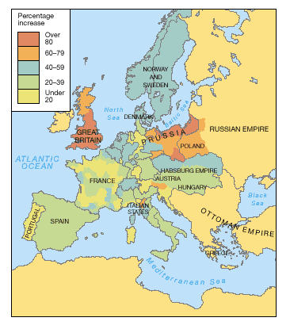
The Emergence of a Mass Society
Population Growth and Emigration
Population increased from 270 mil to 460 mil by 1910
Higher birthrates, lower death rates
Better nutrition and food hygiene
Pasteurization
Emigration
Southern and Eastern Europeans to North America
Left for better jobs and to escape persecution

Slide 7
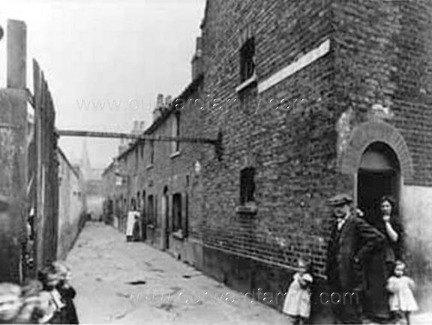
Urbanization
Improving living conditions
Legislation created boards of heath
New housing codes
Clean water
Aqueducts and reservoirs
Development of sewage systems
Housing Needs
Philanthropists built housing
Government began to help encourage better housing to be constructed
Redesigning the Cities
Broad streets
Napoleon III
Tearing down defensive walls
Incorporation of countryside into the city

Slide 8
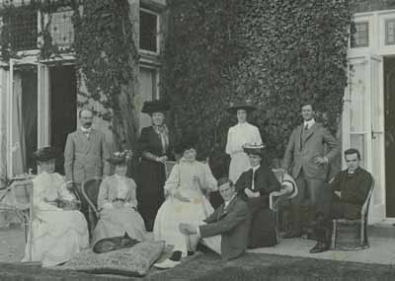
Social Structure of Mass Society
The Elite
Included the top industrialists, bankers, and merchants along with the aristocracy
The Middle Class
Believed in hard work and propriety
Lower Middle Class
Shopkeepers, manufacturers, traders
Upper Middle Class
Lawyers, doctors, and civil service
The Lower Class
Landholding Peasants, agricultural laborers, artisans, unskilled laborers

Slide 9
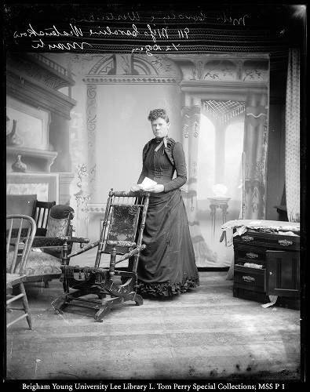
The Role of Women
Considered inferior
Economically dependent
Defined by family and household roles
Marriage glorified and considered only respectable career
Decreased birthrates
Family Planning

Slide 10
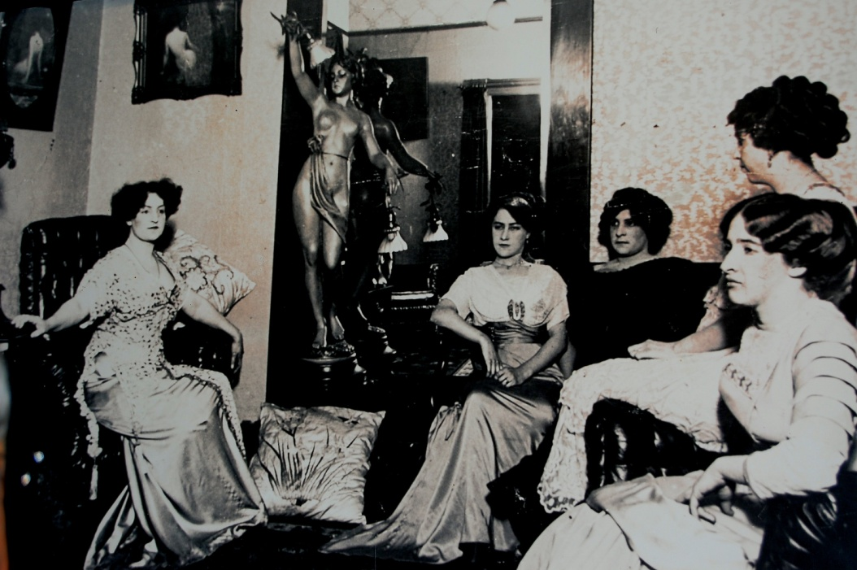
New Job Opportunities for Women
White collar jobs
Service positions
Typists, clerks, secretaries, nursing, teaching
Increased demand for low wage workers and a shortage of male workers led to employers hiring women
Jobs were filled by working class women
Shift from industrial jobs to white collar jobs
Prostitution
Most European countries regulated prostitution
Many lower class women were forced to become prostitutes to survive
Usually rural, working class girls that came to the city for new opportunities

Slide 11
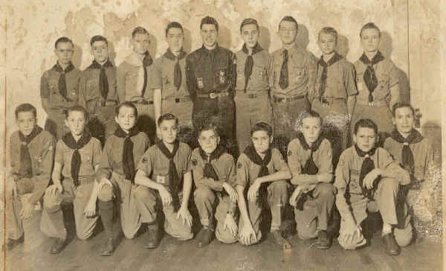
The Middle Class Family
Central Institution
Emphasis on childhood
Boy scouts
Toughen boys up
Feminine education
Singing, playing piano, domestic crafts
Prepared them for creating the proper environment of home recreation
The Working Class Family
Began to depend on income of husband alone
Limited size of families
Smaller families and fewer working hours caused parent to become more involved wit their children

Slide 12
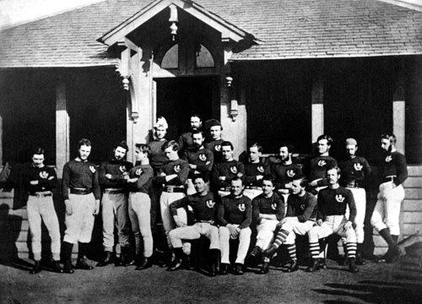
Education and Leisure in the Mass Society Education
State run mass education
Compulsory elementary
Furnished trained workers
Chief motive an educated electorate
Instilled patriotism and nationalism
Middle class values taught
Girls taught less math and no science, focused more on domestic learning
Most teachers were women
Barbara Bodichon was a pioneer in women's education
Virtually eliminated adult illiteracy
Increased circulation of newspapers

Slide 13
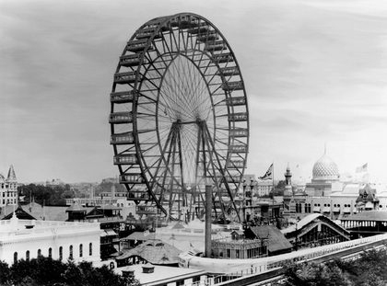
Mass Leisure
New work patterns
Evenings, weekends, and vacation time largely shaped new mass leisure
New technology
Amusement
Ferris wheels
Transportation
“Day-trippers”
Dance Halls
Tourism
Thomas Cook Prostitution
Team sports
Designed to train adolescents
Became regulated and professionalized
Women considered not suitable to participate

Slide 14
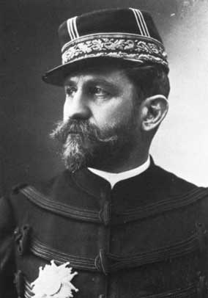
The National State
The Growth of Political Democracy
British reforms
Suffrage
Eliminated pocket boroughs
Irelands move for self government
The Third Republic
Created after napoleon III’s defeat in Franco-Prussian war.
Crushed the commune and massacred over twenty thousand to secure control
Boulanger
Actually rallied support for the republic
Spain and Italy
Italy
Government unable to deal with internal problems
Spain
Limited suffrage
Revolt crushed by conservative government

Slide 15
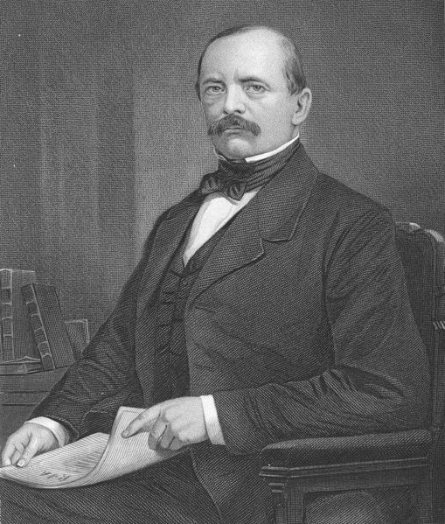
Persistence of the Old Order
Germany
Democracy failed to develop due to Bismarck and the army
Bismarck Began to attack Catholics, then switched to socialists
Failed to stop the growth of socialism and was removed from office by William II
Army answered to emperor only
Selected officers only from “worthy” families
Austria-Hungary
Nationality problem
Austria ruled by Germans and rest of nationalities discontent
Hungarians ruled by repressive Magyars
Russia
Alexander II’s assassination convinced Alexander III to consolidate power
Reforms were repealed
Nicolas II carried on these policies

Slide 16
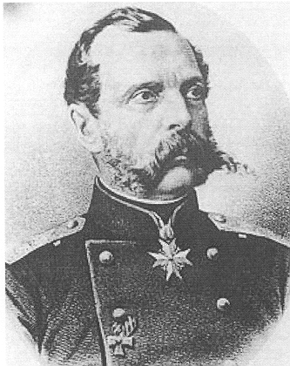
Organizing the Working Class
Socialist parties
Bebel and Liebknecht formed German Social Democratic Party
Second International
Revisionism
Bernstein Evolutionary Socialism
Nationalism
Nationalism more powerful than socialism
Anarchism
Primarily used assasinnations as instruments of terror

Slide 17
Terms, People, and Events
A day-tripper is a person who visits a tourist destination or visitor attraction from their home and returns home on the same day.
Guglielmo Marconi Italian was an Italian inventor, best known for his development of a radiotelegraph system
Gottlieb Daimler was a pioneer of internal-combustion engines and automobile development
August Ferdinand Bebel was a German social democrat and one of the founders of the Social Democratic Party of Germany.
May Day is synonymous with International Workers' Day, or Labour Day, which celebrates the social and economic achievements of the labour movement.
Eduard Bernstein was a German social democratic theoretician and politician, a member of the SPD, and the founder of evolutionary socialism or reformism.
Mikhail Alexandrovich was a well-known Russian revolutionary and theorist of collectivist anarchism
Georges Boulanger was a French general and reactionary politician. During the early days of the newly formed Third Republic, he was the first in a series of scandals that tarnished the Republic known as the Boulanger Affair between 1885-89.
Otto von Bismarck was a Prussian German statesman and aristocrat of the 19th century. As Minister-President of Prussia from 1862–1890, he oversaw the unification of Germany.
The Bessemer process was the first inexpensive industrial process for the mass-production of steel from molten pig iron.
Thomas Cook founded the travel agency and revolutionized travel
Wilhelm II was the last German Emperor and King of Prussia
Nicholas II was the last Tsar of Russia
William Gladstone was a British Liberal Party statesman and four times Prime Minister of the United Kingdom He was also Chancellor of the Exchequer and a champion of the Home Rule Bill which would have established self-government in Ireland.
August Bebel was a German social democrat and one of the founders of the Social Democratic Party of Germany.
Wilhelm Liebknecht was a German social democrat, one of the founders of the SPD
Napoléon III was the first President of the French Republic and the only emperor of the Second French Empire. An important legacy of Napoléon III's reign was the rebuilding of Paris.
Yellow journalism is a type of journalism that downplays legitimate news in favor of eye-catching headlines that sell more newspapers.
Kulturkampf refers to German policies in relation to secularity and the influence of the Roman Catholic Church, enacted from 1871 to 1878 by the Chancellor of the German Empire, Otto von Bismarck.
The Paris Commune was a government that briefly ruled Paris, from March 28 to May 28, 1871. It existed before the split between anarchists and socialists had taken place, and it is hailed by both groups as the first assumption of power by the working class.

Slide 18
Multiple Choice Questions
Annual emigration from Europe to America
A. more than doubled from 1880 to 1900
B. leveled off after 1890
C. had no positive effect to European society
D. contained almost no Jews
Cartels were designed primarily to
A. enrich nation states
B. raise funds for social programs
C. restrain competition that lowered prices
D. provide police protection for companies
Most large city prostitutes were
A. wives bringing in extra money for their families
B. dead by the age of 30 from disease
C. held up for public ridicule in a church at least once in their careers
D. active only for a short time and went on to other work or marriage
Edward Bernstein stressed the need for
A. violent overthrow of capitalist governments
B. extermination of individualists
C. working within the political system to achieve socialism
D. a literal faithfulness to every Marxist theory
The wealthy elite of the new industrial age
A. came to be dominated by upper-middle-class families with fortunes made in industry
B. consisted mostly of landed aristocracy
C. controlled only slightly more wealth than did all the working class
D. was more open to admission by newcomers in Russia than in any other country

Slide 19
Answers
1. A
2. C
3. D
4. C
5. A

