Slide 1
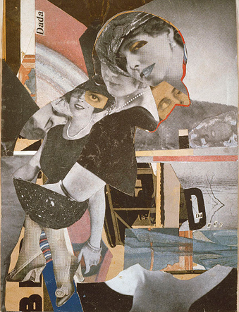
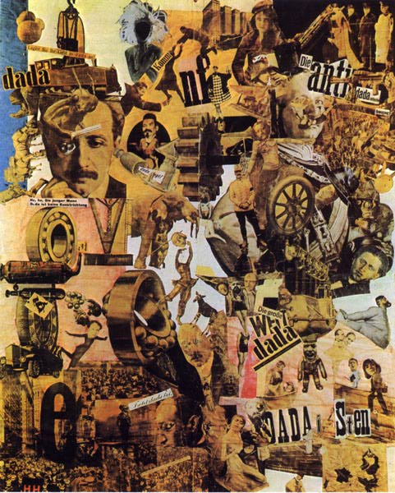
Age of Depression, Democracy and Culture 1919-1939
By: Luis Giraldo
(Authoritarian and Totalitarian Movements also present but up to Michael Bertino to Present)

Slide 2
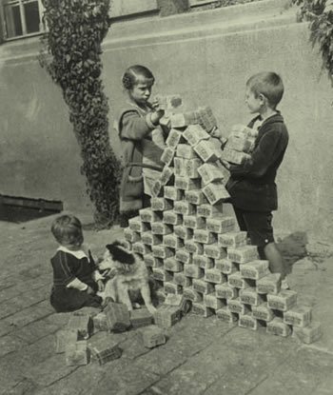
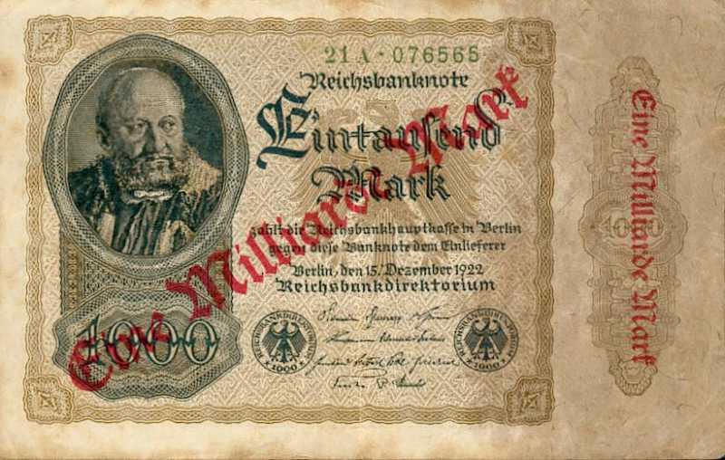
Search for Security
France strictly enforced the details of the Treaty of Versailles. Among all the issues, the most important had to do with Reparations, which was the payment supposed to compensate for the ”damage” done in WWI. Since the Germans could not pay the sum of $33 Billion the French was forced to occupy the Ruhr Valley and operate its Mines and Factories. The German coin soon became worthless and the economy went down the tubes. They were soon pressured by Great Britain and the United States to pursue a more conciliatory approach toward Germany.

Slide 3
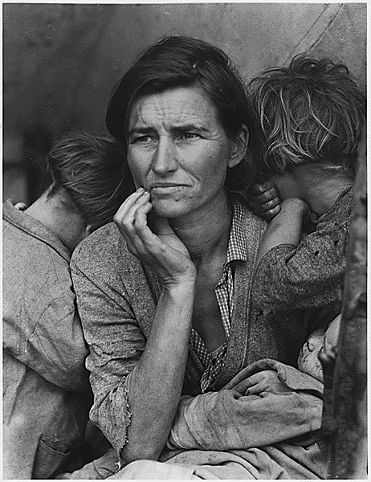
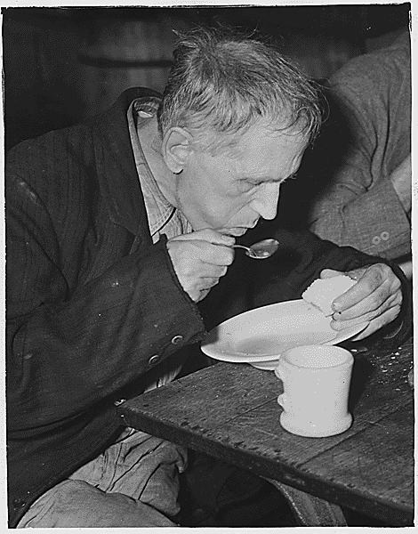
The Great Depression
Mostly brought about by a downturn in domestic economies and an international financial crisis caused by the collapse of the American stock market in 1929.
Europe’s prosperity had been built on American loans.
American Investors begun pulling money out of Germany to invest it in the stocks.
The Credit-Anstalt Bank Collapsed in 1931.
Unemployment increased and the industry started cutting back on production so inflation erupted.
Democrats lowered wages and raised tariffs which only worsen the situation.
This is when communism took on new popularity, especially among workers and intellectuals.

Slide 4
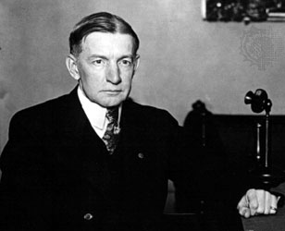
The Hopeful Years (1924-1929)
The Dawes Plan was introduced to reduce reparations and stabilize Germany’s payments on the basis of its ability to pay. it also granted an initial loan of $200 million for German recovery.
Treaty of Locarno also guaranteed Germany’s western borders with France and Belgium.
The Kellogg-Briand pact was introduced which called for the “renouncement of war as an instrument of national policy.”
Public relations were established by many European countries with the Soviet Russia.

Slide 5
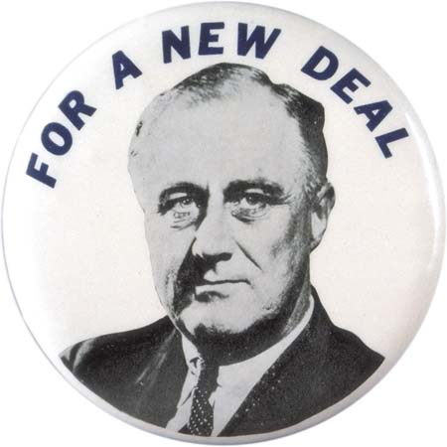
Democratic States Continued
The Scandinavian states were particularly successful in coping with the great Depression. The social democratic governments encouraged the development of rural and industrial cooperative enterprises. These enterprises also expanded social services.
In the United States unemployment was at an all time high. FDR pursued a policy of active government intervention in the economy that came to be known as the New Deal. This reform plan provided some social reform measures and financial aid plans for all of those in need.

Slide 6
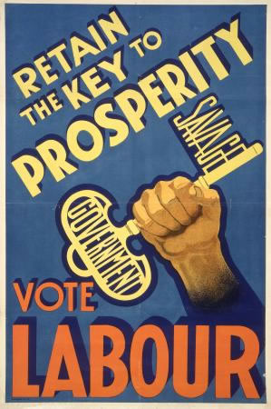
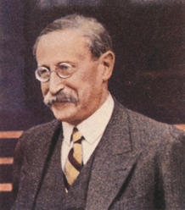
The Democratic States
Great Britain went through great period of economic difficulties. Unemployment rise and decline in staple industries was evident after the war. In 1923, the nation underwent a major transformation when the Labour Party surged ahead of the Liberals. Ramsey MacDonald became Prime Minister. He only lasted 10 months. Stanley Baldwin led the conservatives to renewed prosperity from 1925 to 1929. as the nation fell into depression it took a National Government to restore stability through means of balanced budgets and protective tariffs.
France voted Poincare’s national Bloc out of power and replaced it with the Cartel of the Left, which was a coalition government formed by two French leftist parties, the Radicals and the Socialists. France began to feel the impact of the depression and underwent a nineteen-month period of six different cabinets de to political chaos. In 1936 the first Popular Front government was formed which initiated what was called by some the French New Deal. However, they too were unable to solve the problems of the depression.

Slide 7
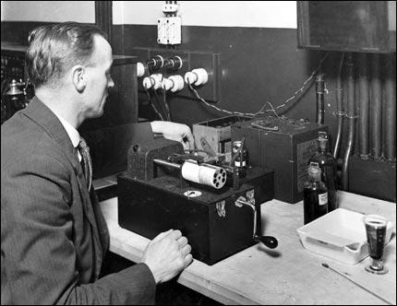
Radio and Movies
A series of technological inventions in the late nineteenth century led to a revolution in the area of mass communications. The discovery of the wireless radio wave and the production of full length motion pictures. All of these new forms of communication had an impact on everyday life due to the potential to publicize propaganda.

Slide 8
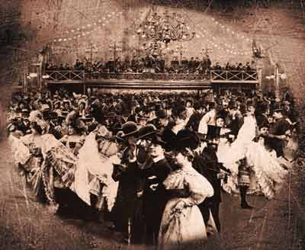
Mass Leisure
By the 1920, he eight-hour day had become the norm for many office and factory workers in northern and western Europe. professional sporting events for mass audiences became an especially important aspect of mass leisure. Travel opportunities also added new dimensions to leisure activities. In totalitarian regions new ways to control the populations came about because of mass leisure such as the Dopolavoro.

Slide 9
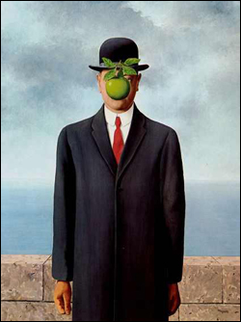
Trends in the Interwar Years
Abstract became popular since prewar fascination with the absurd and the unconscious seemed even more appropriate after the nightmare landscapes of WWI battlefronts. Dadaism attempted to enshrine the purposelessness of life. artists such as Tzara embodied such ideology. Also, surrealism sought a reality beyond the material, sensible world and found it in the world of the unconscious through the portrayal of dreams, fantasies, or nightmares. The move to functionalism in modern architecture also became more widespread in the 1920s ad 1930s. The united states was a leader in these pioneering architectural designs.

Slide 10
The Search for the Unconscious
The search for the unconscious was also apparent in the new literary techniques that emerged in the 1920s. Writers such as Woolf and Hesse embodied the unconscious in their works. Also, the influence of Carl Jung, and his psychological theories on dreams also had an impact in surrealism and emphasized that dreams were openings to deep spiritual needs and ever-greater vistas for humans.

Slide 11
Quick Quiz!!!!
What is the Dada movement?
Something your Parents made up
A movement that attempted to enshrine the purposelessness of life
A hip new dance move
Who Paid Reparations after WWI and how much?
Canada; 1 Cent
Kenya; 2 Billion
Germany; 33 Billion
Who is the Wonderful man with Polio on the propaganda pin?
FDR
Michael Bertino
Mr. Farrell on a bad day

Slide 12
Two More!!!!
Why was the Dawes Plan important?
It Just was
It reduced reparations for Germany and opened the door to heavy American investments in Europe.
IDK my BFFL Jill
Who was the author of the General Theory of Employment, Interest and Money?
George W. Bush
A Communist
John Maynard Keynes

